Slide 1
FINANCIAL AGENT
Digital Financial Literacy Agent
Student name : U. LITHIN PAVAN SAI
Department : CSE ( CYBER SECURITY )
College Name : Kakinada institute of engineering and technology

Slide 2
OUTLINE
Problem Statement
Proposed Solution
Technology used
IBM cloud sevices used
WOW factors
Result
Conclusion
Future scope
IBM certifications
Git-hub link

Slide 3
Problem Statement
A significant portion of the population lacks confidence and knowledge in navigating the digital financial landscape. This "digital literacy gap" creates major barriers, making individuals vulnerable to online scams, high-interest debt, and poor financial decisions. Key challenges include:
Complexity: Financial tools like UPI, net banking, and credit scores can be intimidating.
Accessibility: Reliable financial information is often fragmented across different platforms and filled with jargon.
Language & Culture: Most financial guidance is not available in regional languages or tailored to specific cultural contexts, excluding large segments of the population.
Security Risks: Without proper knowledge, users are prime targets for phishing, fraud, and financial scams.

Slide 4
PrOPOSED SOLUTION
I propose an AI Agent for Digital Financial Literacy, powered by Retrieval-Augmented Generation (RAG). This agent acts as a personal, trustworthy financial guide.
It retrieves and synthesizes reliable, up-to-date content from verified sources like government portals (e.g., RBI, SEBI), banking websites, and reputable educational platforms. With robust multilingual support, users from diverse backgrounds can interact in their preferred language and get clear answers to critical questions like:
“How do I send money safely using UPI?”
“What are the signs of a loan scam?”
“Explain credit card interest rates in simple terms.”
The agent's goal is to make financial literacy accessible, personalized, and culturally inclusive, empowering users to manage their finances with confidence.

Slide 5
Technology used
Natural Language Processing (NLP): To understand and process user queries in multiple languages and conversational styles.
Retrieval Augmented Generation (RAG) : To ensure answers are grounded in factual, reliable data from a curated knowledge base of trusted financial sources.
IBM Granite model : As the core large language model to generate clear, coherent, and helpful responses.

Slide 6
IBM cloud services used
IBM Cloud Watsonx AI Studio : For Building, managing, and deploying the AI agent.
IBM Cloud Watsonx AI runtime : To ensure answers are grounded in factual , reliable data from a curated knowledge base of trusted financial sources
IBM Granite foundation model : as the core large language model to generate clear , coherent and helpful responses.

Slide 7
Wow factors
This agent moves beyond generic advice to provide a truly empowering user experience.
Financial Inclusion: By offering multilingual support, it brings essential financial knowledge to rural and non-English speaking populations.
Trust and Safety: The RAG approach ensures information is not hallucinated but sourced from verified, authoritative documents, protecting users from misinformation.
Personalized Education: Users can learn at their own pace, asking specific questions relevant to their immediate needs without feeling judged.
Proactive Fraud Prevention: Empowers users with the knowledge to identify and avoid common online scams, acting as a first line of defense.

Slide 8
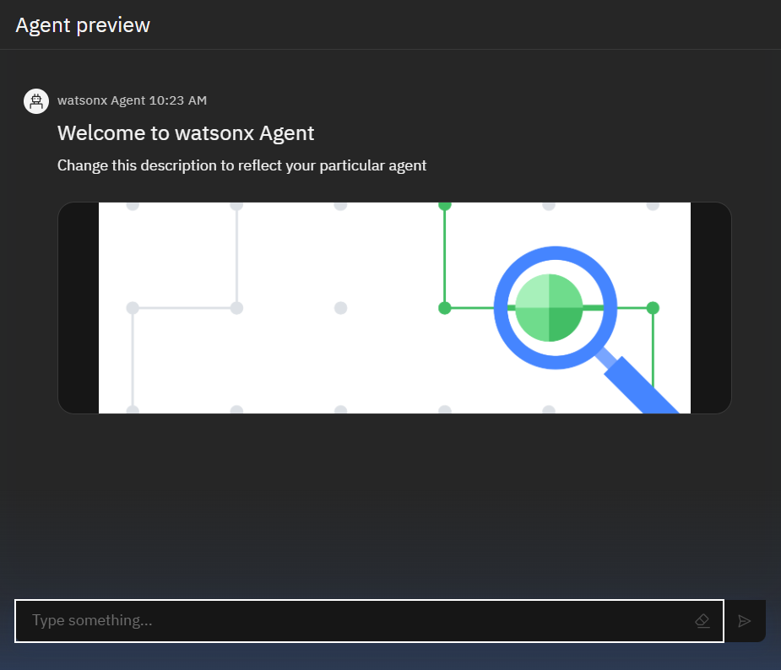
Results

Slide 9
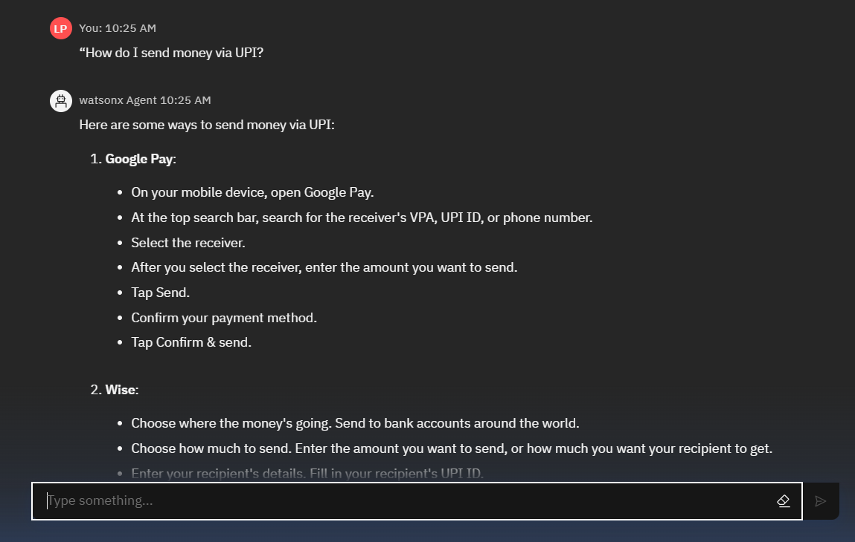
Results

Slide 10
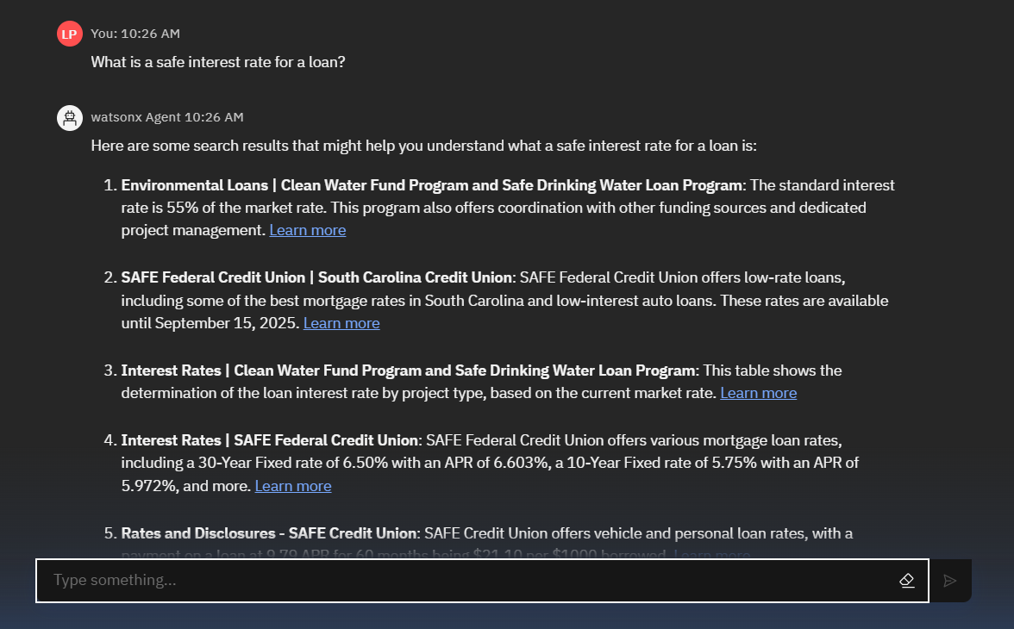
Results

Slide 11
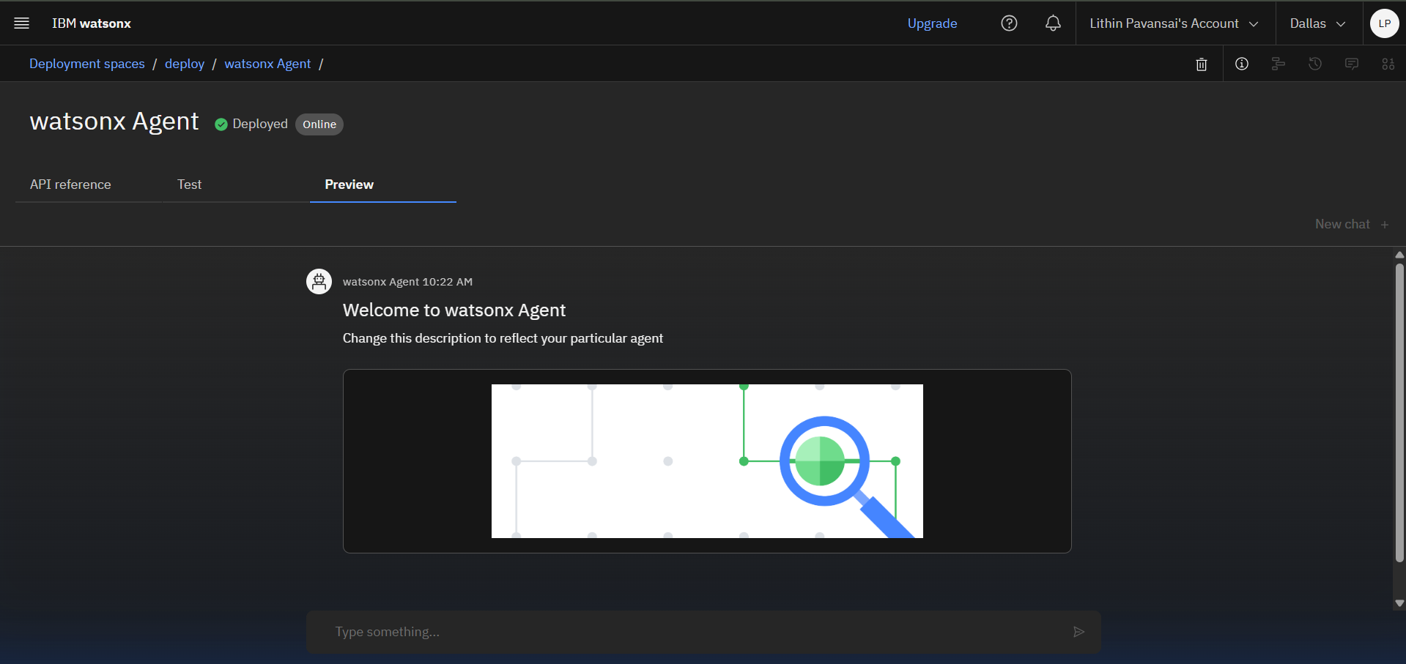
Results
Deployed AI Agent

Slide 12
Conclusion
The Digital Financial Literacy Agent is more than a chatbot; it is a vital tool for economic empowerment and digital inclusion. By leveraging AI to deliver trustworthy, accessible, and personalized financial guidance, it directly addresses the digital divide. This agent empowers users with the knowledge to protect themselves from fraud, build wealth, and confidently participate in the modern financial world.

Slide 13
Future scope
Personalized Budgeting tools
Proactive Alerts
Gamified learning Modules
Integration with banking apps
Voice – Activated Interaction

Slide 14
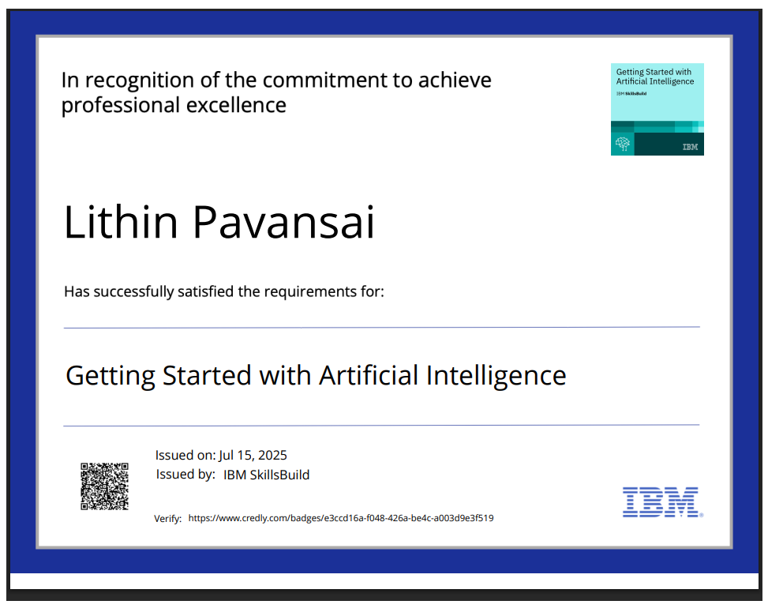
IBM Certifications

Slide 15
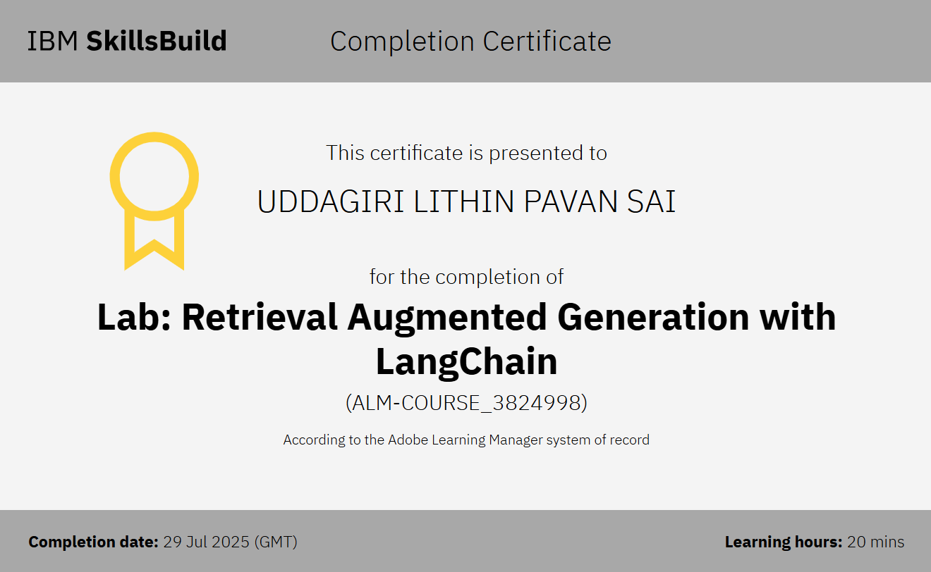
IBM Certifications

Slide 16
GITHUB LINK :
https://github.com/Pavansailithen/financial-literacy-agent

Slide 17
THANK YOU

